Slide 1


Peer-graded Assignment: Capstone Project - The Battle of Neighborhoods (Week 2)
By
Ritu

Slide 2

Objective:
To Predict Best Location to Open a Gym in Bangalore by ABC Gym

Slide 3

Background:
ABC Gym
An American chain international co-ed fitness centre
Branches are located all over the world
Wants to open a branch in Bangalore, India

Slide 4




Business Problem:
The client needs the help of analyzing the prospect of finding the right location to start the business which will ensure that the business can deliver good amount of profit on a long run.

Slide 5
Factors to Study:
• Bangalore Population
• Bangalore City Demographics
• Is there any office or commercial place nearby?
• Is there any Park or Playground nearby?
• Who are the competitors in that location?

Slide 6

Data acquisition and cleaning:
• Data sources
Postal codes of Bangalore:
https://www.mapsofindia.com/pincode/india/karnataka/bangalore/
Geospatial Data of India:
https://data.gov.in/sites/default/files/all_india_PO_list_without_APS_offices_ver2_lat_long.csv.

Slide 7
Methodology
Scraping the table from the web: Data downloaded or scraped from multiple sources were combined into one table to obtain final location data for Bangalore, Karnataka.
Clustering the neighborhoods in Bangalore: The Foursquare explore function is used to get the most common venue categories in each neighborhood, and then used this feature to group the neighborhoods into clusters
k-means clustering for analyzing the data of neighborhoods in Bangalore
Folium library to visualize the neighborhoods in Bangalore and their emerging clusters

Slide 8
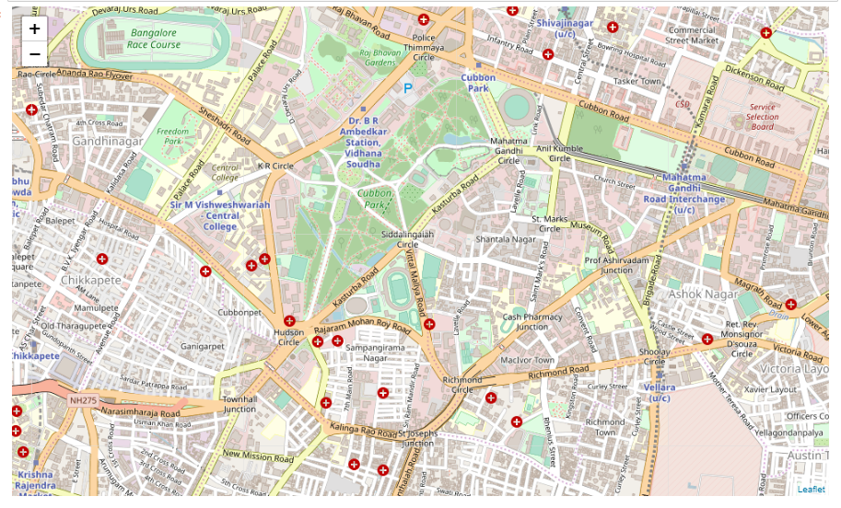
Map of Bangalore Locations

Slide 9
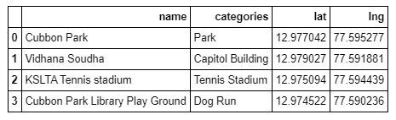
Top venues
Foursquare API : to explore and analyze the Neighborhood.
Top 4 venues were returned by Foursquare for the area of our interest.

Slide 10

TOP 10 venues
The venues for all Bangalore neighborhoods were clustered in groups using the common venues.
There are 143 unique venue categories found in Bangalore.
The neighborhoods were grouped by taking the mean of the frequency of occurrence of each category.
Then the top 10 venues per neighborhood were obtained.
These venues were analyzed and studied.

Slide 11

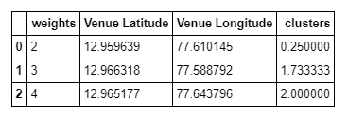
Best scored neighborhood
Weights were assigned to some of the categories which are linked to the Gym.
Based on the weightage, the Best scored Neighborhoods were selected:

Slide 12
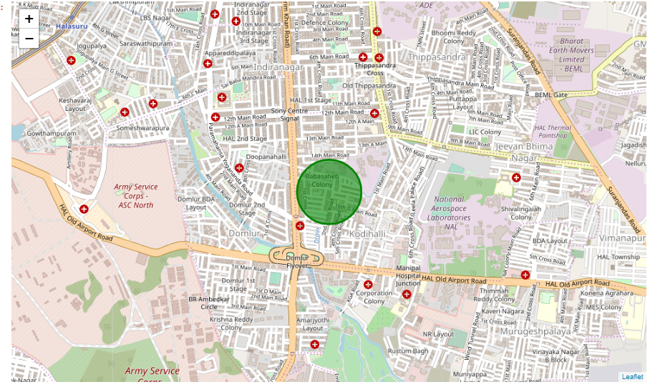
Results
The top score is 4 for the coordinates, latitude = 12.965177; longitude = 77.643796.
The coordinates were plotted on the Bangalore map to show that the Gym can be opened within the circle in green color .

Slide 13
Conclusion
We finally got a location in the Bangalore to open the Gym.
This place is between the Domlur and the H.A.L II Stage.
ABC Gym can consider this location for venturing their business idea.

Slide 14
Thank you

